Slide 1

Subscribe to DeepL Pro to edit this document.
Visit www.DeepL.com/pro for more information.

Slide 2
Block
The block may contain information about:
  Transactions
    P da y a Q
  States
    P has n instances of x
  Conditions
    Contracts
      if < transaction> then < transaction>
    Inferences
      if < state> then < state>
The block size is 1 MB of transactions.
  Fixed in the initial version of the protocol.

Slide 3
Blockchain
A blockchain (or Blockchain) is a linked list whose nodes link to its predecessor by hashing its contents.

Slide 4
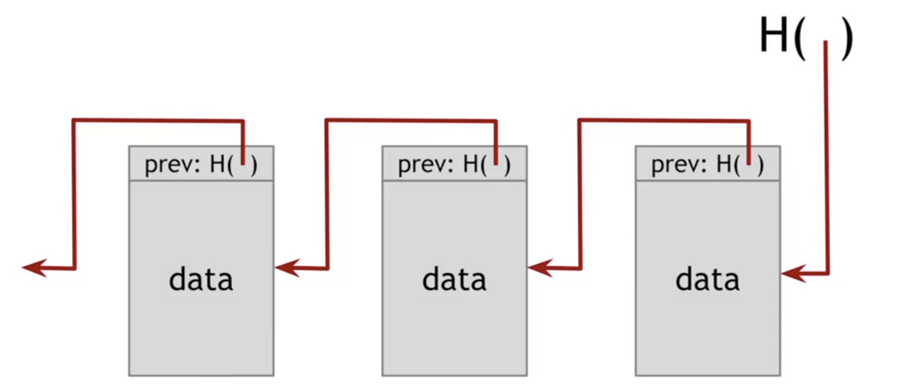
Blockchain structure (1/4)
Linear sequence of data
  Transitive hash function

Slide 5
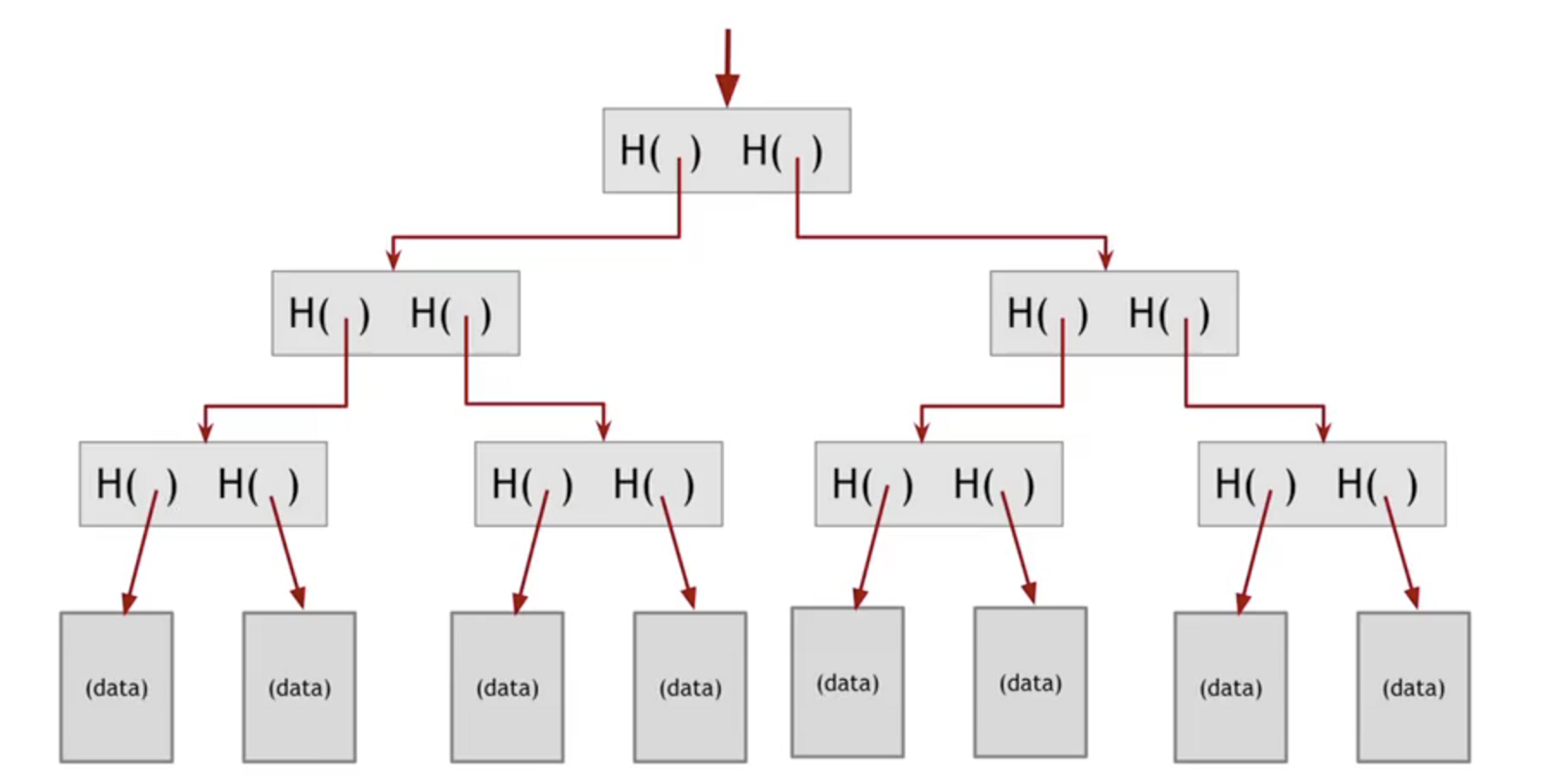
Blockchain structure (2/4)
Data sets
  Merkle Tree
  Easier and faster to check individual transactions.

Slide 6
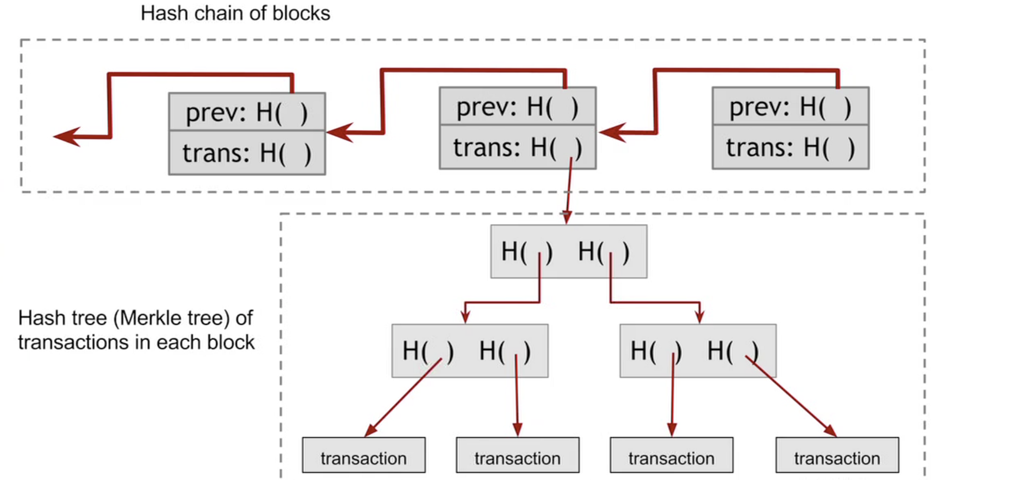
Blockchain structure (3/4)

Slide 7
Blockchain structure (4/4)
Notes:
DOLADER, BEL Y MUÑOZ.pdf

Slide 8
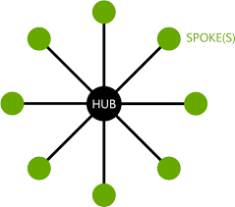
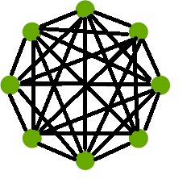
Decentralization
Blockchain is a decentralized P2P network.
Each node has a copy of the ledger.
Traditional "Hub and Spoke" scheme with centralized BD
Blockchain network with decentralized ledgers

Slide 9
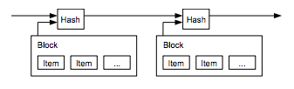
Avoiding the problem of double spending
The usual solution is a central authority to verify this.
  And if not?
Time stamp servers (timestamp)
  Generate the timestamp of a block and publish it
    Proof that the data existed at that time.
    The timestamp of the block includes the timestamp of the previous blocks.
  What if there are several?
    Consensus mechanisms

Slide 10
Consensus mechanisms
They ensure that the next block added to a blockchain is the only authentic version.
It prevents powerful participants (adversaries) from corrupting the system and successfully forking the chain.

Slide 11
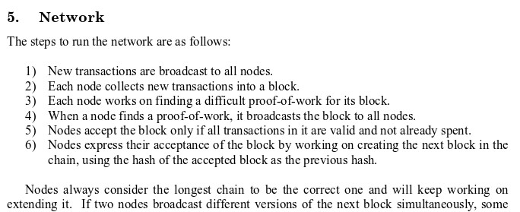
Proof of work
Nakamoto's article sets out how to secure a Blockchain against attacks through a proof of work.
  It is the great novelty of his work

Slide 12
Proof of work
PoW involves looking for a "nonce" value that, when combined with a combined hash of all transactions in a block, the resulting hash starts with a certain number of zero bits.
Notes:
BLOCKCHAIN.pptx
It can only be found by "brute force", there are no analytical methods.

Slide 13
Proof of work
It is essentially a voting mechanism.
  1 CPU = 1 vote.
The majority decision is represented by the longest blockchain.
  In which PoW has invested the most effort.
If most of the CPU power is controlled by honest nodes, the honest chain will grow faster and outperform competing chains.
  Modifying a past block would require redoing the PoW of the block and all subsequent blocks, until the chain of honest nodes is exceeded.
  51% attack

Slide 14
Consensus methods
Proof of Work (Nakamoto consensus)
Proof of State
Proof of Elapsed Time
Proof of Burn
Proof of Capacity
Proof of Importance
Proof of Stake (proof of participation)
  Ex. PeerCoin, https://peercoin.net/
Proof of Replication
  E.g. Filecoin, https://filecoin.io/
…

Slide 15
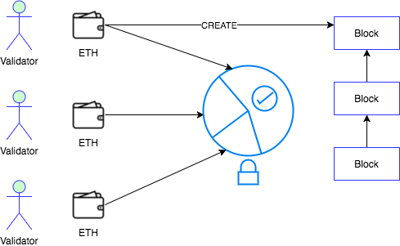
Participation test

Slide 16
Participation test
Proof of Stake (PoS) is a category of consensus algorithms.
  For public blockchains.
  They depend on the economic participation of a validator in the network.
It is not necessary to consume large resources to secure a blockchain.
  Resource = Computation and energy
Therefore, it is not necessary to issue so many new coins to motivate participants to continue participating in the network.
  Game theory mechanisms to discourage centralized cartels.
Ability to use economic sanctions to make 51% attacks much more expensive to carry out.

Slide 17
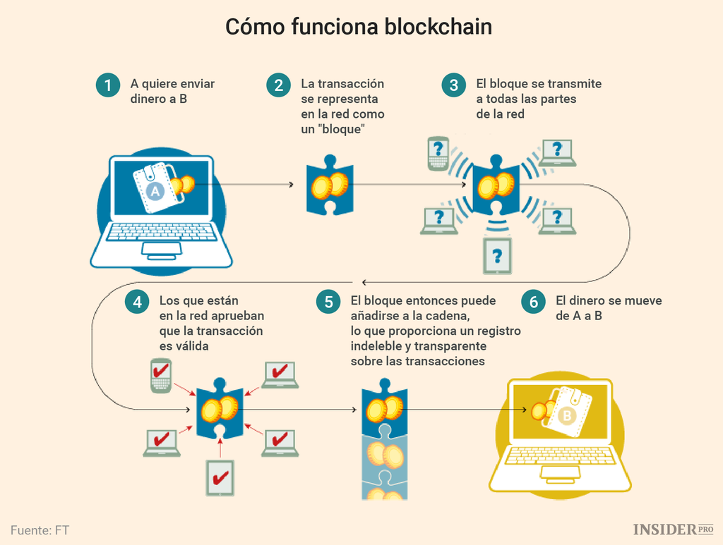
Networking

Slide 18
Networking
New transactions are transmitted to all nodes.
Each node collects and verifies new transactions in a block.
Each node works to find a difficult proof of work for its block.
When a node finds a proof of work, it broadcasts the block to all nodes.
Nodes accept the block only if all transactions in it are valid and have not been spent.
Nodes express their acceptance of the block by working to create the next block in the chain, using the hash of the accepted block as the previous hash.
Here
Node = Miner
But they are different
Watching Bitcoin mining

Slide 19
Node logic
Nodes always consider the longest string to be the correct one.
  And they work on it to extend it.
If two nodes transmit different versions of the next block simultaneously, some nodes may receive one or the other first.
  They work on the first version they received, but keep the other branch in case it turns out to be the longer one.
The tie is broken when the next working test is encountered and one branch becomes longer.
  The nodes that were working on the other branch switch to the longer branch.

Slide 20
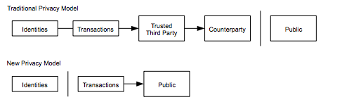
Privacy
Traditional model, limiting access to information.
  Parties involved and trusted third party.
The need to publicly announce all transactions precludes this method.
  Privacy by keeping public keys anonymous.
Notes:
BLOCKCHAIN.pptx

Slide 21
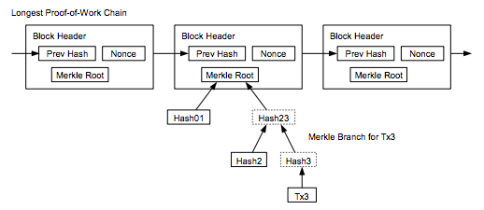
Transaction Verification

Slide 22
Transaction Verification
A user only needs to keep a copy of the block headers of the longest string.
  Which you can get by querying network nodes until you are convinced you have it.
  Full vs light vs lightning nodes
You can't verify the transaction yourself, but by linking it to a place on the chain, you can see that a network node has accepted it and the blocks added after you further confirm that the network has accepted it.
Notes:
https://www.coindesk.com/information/how-do-bitcoin-transactions-work
https://nodes.com/

Slide 23
Distributed and immutable registry
Blockchain retains data across transactions.
  As in conventional databases.
In Blockchain it is "almost impossible" to change the data once it is written in the chain.
  Blocks can be changed, but it is extremely difficult to do so.
  Requires rework in all blocks subsequent to the modified and consensus of each.
So, in general, the transaction is immutable or indelible.
  In terms of DB, blockchains are write and read only.
  Like an accounting ledger written in ink, an error would be resolved with another entry.

Slide 24
Incentives
By convention, the first transaction in a block is a special transaction that initiates a new coin owned by the block creator.
  Incentive for nodes to work for the network
  Mechanism for the initial distribution of coins in circulation
    Since there is no central authority to issue them.
The continued addition of a constant quantity of new coins is analogous to gold miners expending resources to add gold to circulation.
  Here CPU and electricity what is spent.

Slide 25
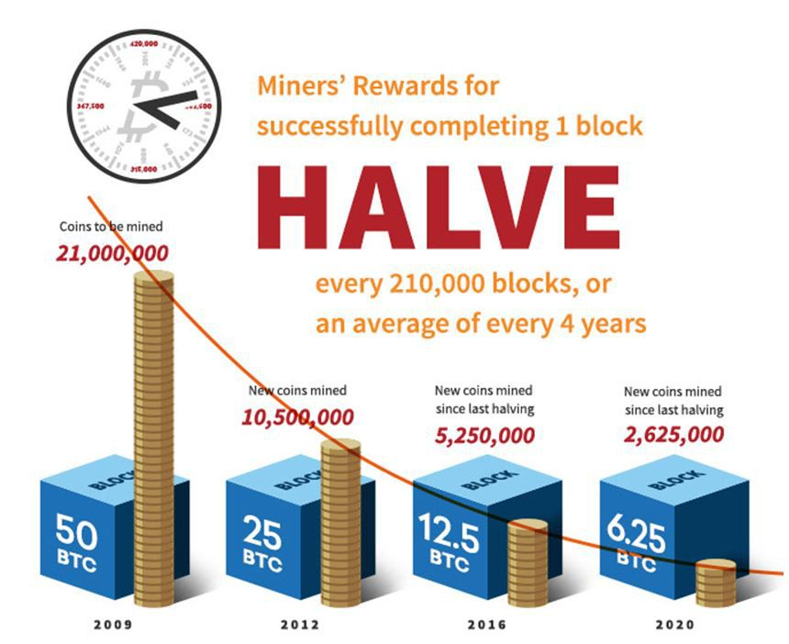
Incentives
Updated information at

Slide 26
Incentives
Can it be profitable for me?
  Crypto Compare
  Coin Warz
  What to Mine
  …

Slide 27
Incentives
Miners can choose the transactions they work on.
  Those that add to the blocks.
They may charge a transaction fee.
  Next rate, 3 or 6 blocks
Without a fee the transaction may be delayed.
  Days, weeks or be rejected
Notes:
https://www.investopedia.com/tech/how-does-bitcoin-mining-work/

Slide 28
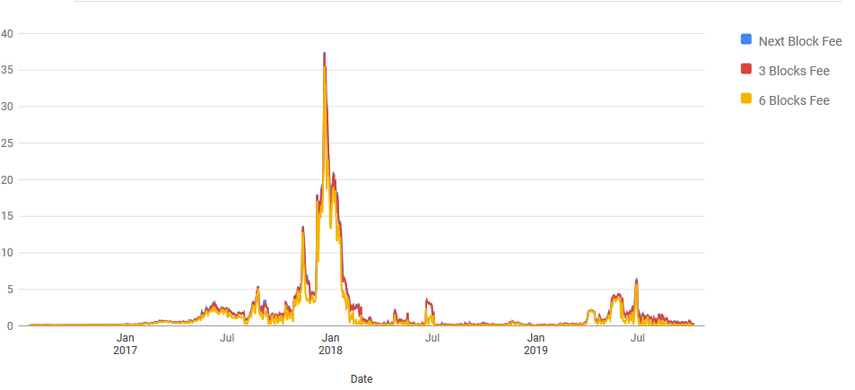
Incentives
Rate in dollars per transaction

Slide 29
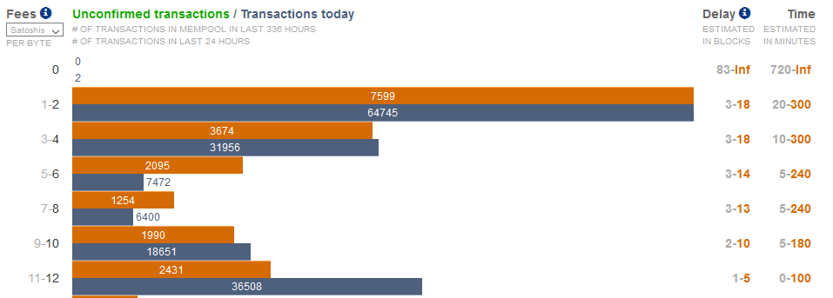
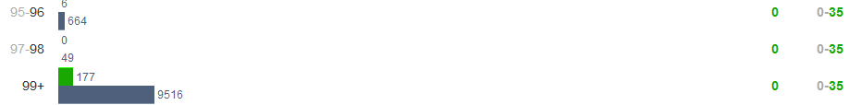
Delays
Notes:
1 Satoshi = 0.00000001 BTC

Slide 30
Incentives
Miners have a vote in the future of the network.
  Change the block size?
  Make a fork?
    Hard vs soft
  Allow more Bitcoins?
Notes:
https://www.investopedia.com/tech/how-does-bitcoin-mining-work/

Slide 31
Evolution

Slide 32
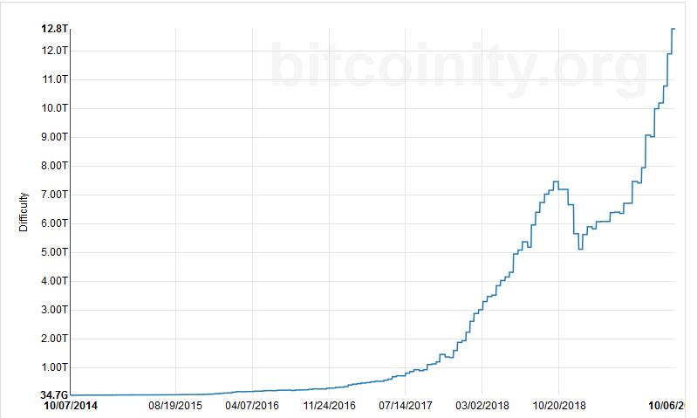
Hash difficulty - Bitcoin
7/10/2019
Changes every 2016 blocks

Slide 33
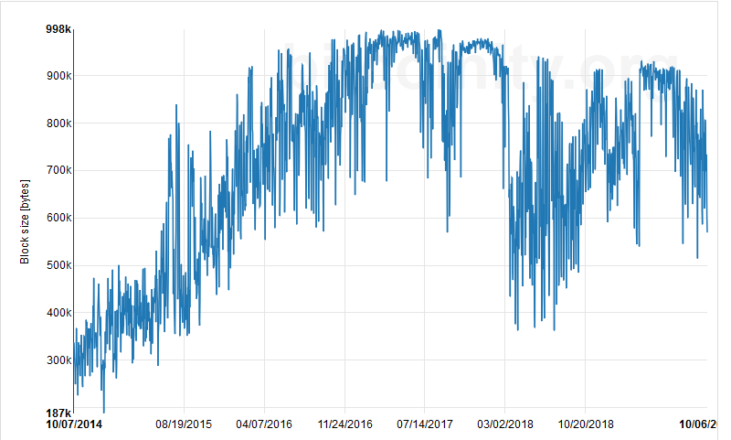
Block size - Bitcoin
7/10/2019

Slide 34
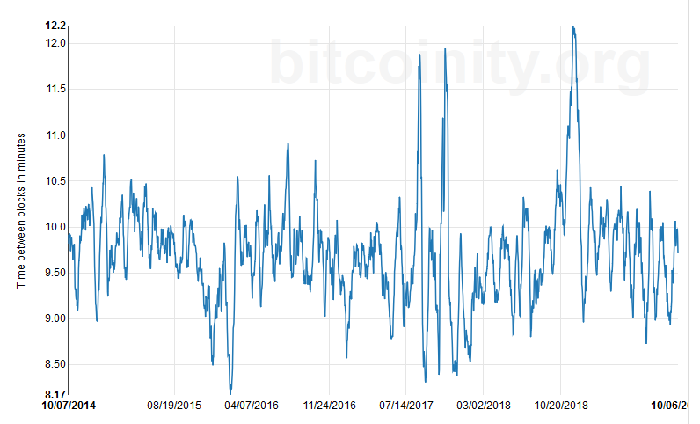
Time between blocks - Bitcoin
7/10/2019

Slide 35
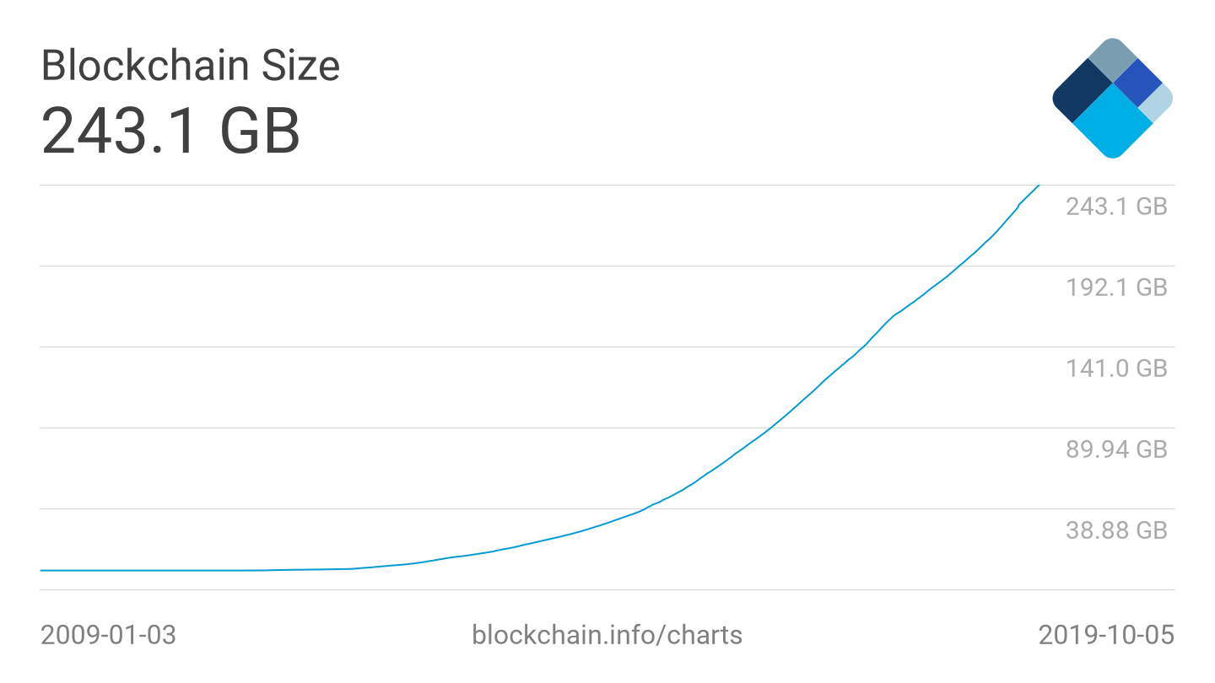
Ledger size - Bitcoin

Slide 36
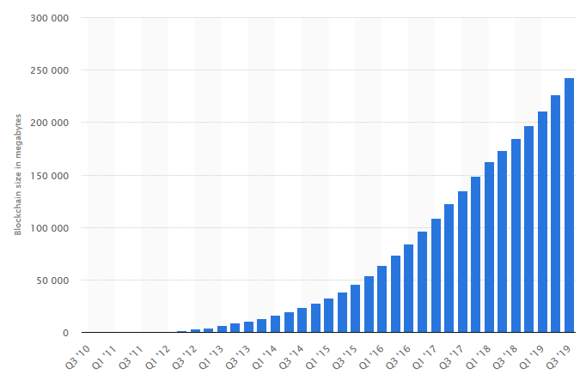
Ledger size - Bitcoin

Slide 37
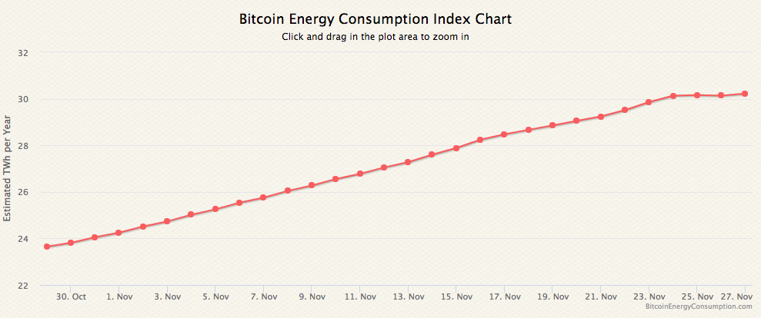
Transaction costs - Bitcoin
Computationally and energy expensive

Slide 38
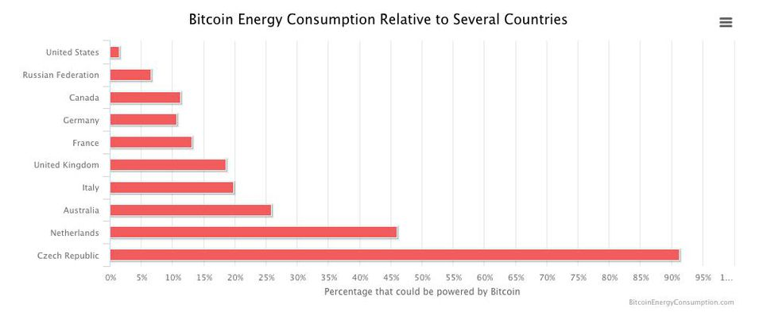
Power consumption

Slide 39
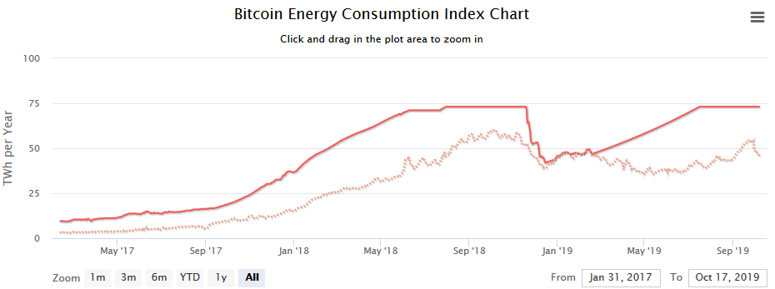
Power consumption

Slide 40
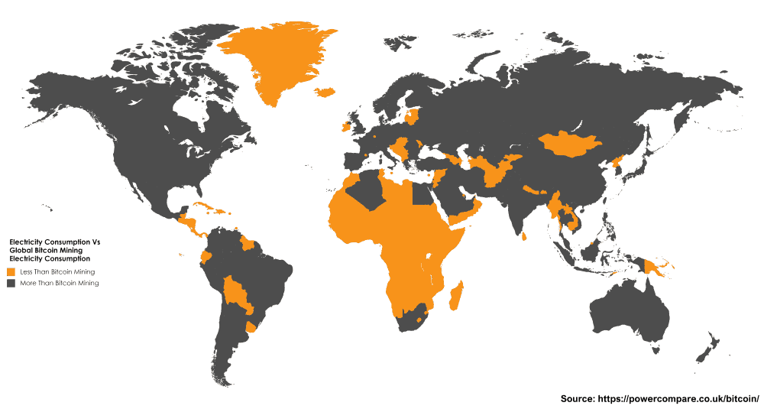
Power consumption
November 2017

Slide 41
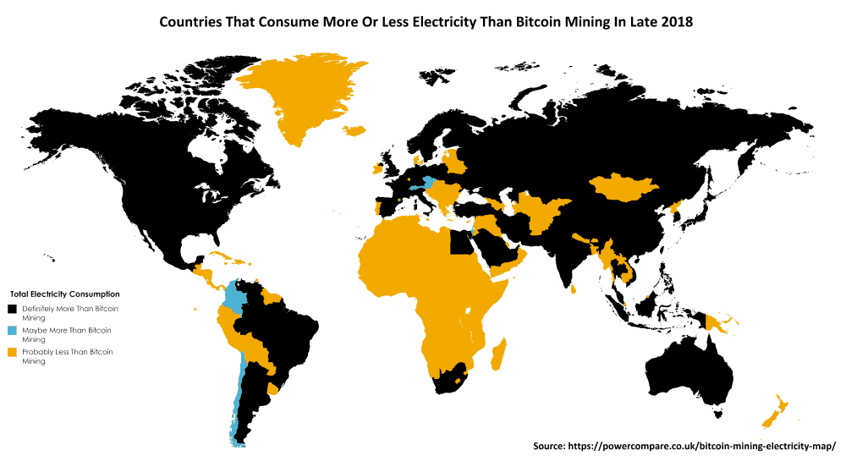
Power consumption
Finals 2018

Slide 42
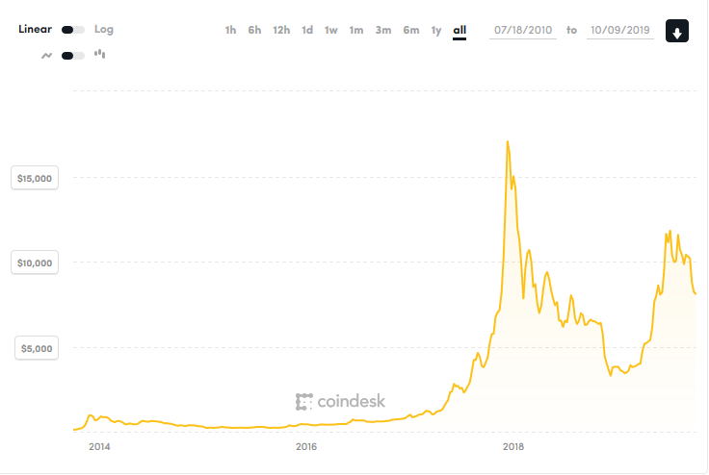
Price - Bitcoin

Slide 43
And when the Bitcoins run out?
A maximum of 21 million bitcoins can be generated.
It is not known when it will arrive.
  Currently 75% has been mined but it is becoming increasingly difficult.
  In 2009 you could mine 200 Bitcoins with a PC
  In 2015 it would have taken 98 years to mine just 1 Bitcoin.
Transaction fees
  Will it be enough?

Slide 44
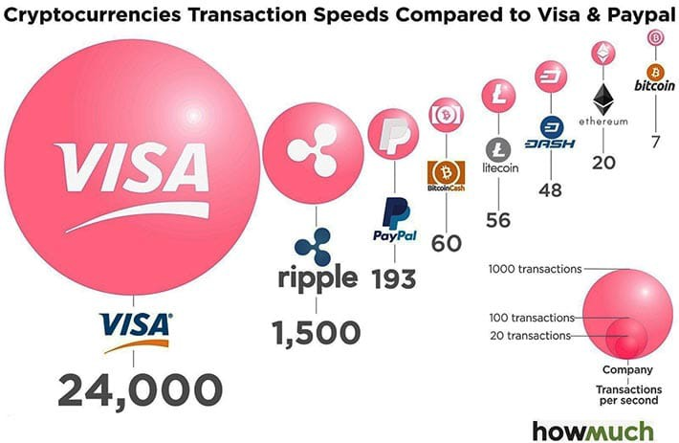
Speed of transactions
https://medium.com/@johnhinkle_80891/the-fastest-cryptocurrency-transaction-speeds-for-2018-498c1baf87ef

Slide 45
Public vs. private blockchains
Public Blockchains are encrypted but visible to the public.
  E.g. https://www.blocktrail.com/BTC
Private ones employ user rights for visibility.
  Ex. permissions
    Client: write and display all data
    Auditors: view all transactions
    Vendor A: writes and displays the data of partner A
    Vendor B: writes and displays the data of partner B

Slide 46
Other applications
Alternative altcoins to Bitcoin
Tokens on the Bitcoin Blockchain
  ColoredCoins ( https://coloredcoins.org/ )
  CounterParty ( https://counterparty.io/ )
Decentralized DNS
  NameCoin ( https://www.namecoin.org/ )
Storage
  Storj ( https://storj.io/ )
  Filecoin ( https://filecoin.io/ )
Computing
  Golem ( https://golem.network/ )

Slide 47
Other applications: currency and financial
Payments
  Square ( https://www.coindesk.com/square-gets-a-bitlicense-new-york-crypto/ )
Gift Cards
  Gyft ( https://www.gyft.com/bitcoin/ )
  eGifter ( https://www.egifter.com/ )
Financial Services
  Banks ( https://www.ethnews.com/gmo-internet-group-creates-a-bank )
  Hedge funds ( https://www.bitwiseinvestments.com/fund )
  Bonds and liquidity ( https://ripple.com/solutions/source-liquidity/ )
  Crowdfunding ( https://www.idgconnect.com/blog-abstract/30700/blockchain-africa )

Slide 48
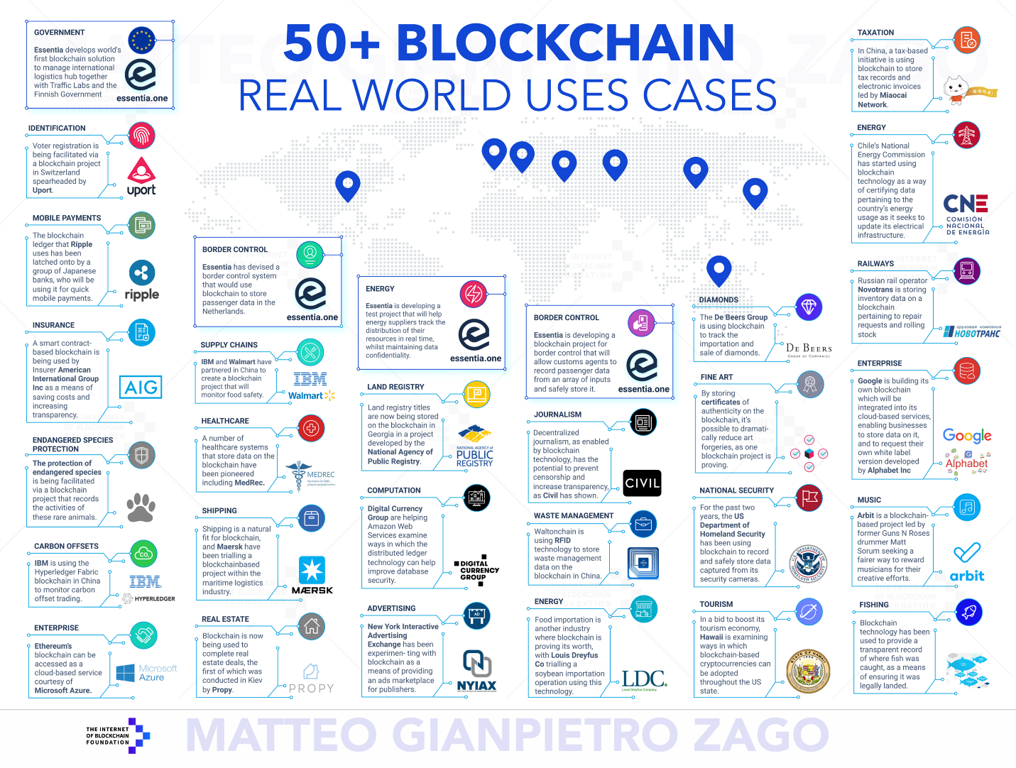
Other applications
https://medium.com/@matteozago/50-examples-of-how-blockchains-are-taking-over-the-world-4276bf488a4b

Slide 49
Ethereum and smart contracts

Slide 50
Smart contracts
Encoding clauses into source code in a manner which is automatically self-enforced and executed without the need for a central authority, in the form of smart contracts (Szabo, 1997).
Emulates traditional contract (voluntary agreement between parties)
Trustless
Automatic application (self-enforcement)

Slide 51
Smart contracts on the Blockchain
Smart Contracts:
  small programs
  that are deployed on the blockchain
  are executed by the nodes of the network.
  operate autonomously:
    independent of "third parties" to operate
    potentially uncontrollable
Provides a layer of business logic prior to sending blocks.

